Slide 1

Student Details
Name : NAMYA PATIYAL
Skill build email ID : namyapatiyal888@gmail.com
College name : Manipal Institute of Technology
College state : Karnataka
Internship domain : ARTIFICAL INTELLIGENCE
Start date-end date : 12/06/2023 -24/07/2023

Slide 2
PROJECT TITLE: AI/ML Project - Mental Health Fitness Tracker
Problem Statement : AI/ML-Powered Mental Health Fitness Tracker: The project aims to create a mental health fitness tracker that utilizes artificial intelligence and machine learning techniques to enhance its functionality. AI/ML algorithms will be employed to analyze complex patterns, detect anomalies, and draw meaningful insights from the user's data.
Accurate Mental Health Assessment: The primary objective of the mental health fitness tracker is to provide accurate assessments of the user's mental health status. It will achieve this by integrating various data points and employing advanced AI algorithms to interpret the information effectively.

Slide 3
AGENDA
1. Introduction and Objective:
- Introduce the project's goal: Developing a mental health fitness tracker using regression models in Google Collaborator
- Explain the importance of mental health monitoring and the intended benefits for users.
2. Data Collection and Preprocessing:
- Describe the process of collecting user responses through prompted questions.
- Discuss the data preprocessing steps to prepare the data for regression modeling.
3. Regression Model Selection and Training:
- Present the chosen regression models for mental health prediction.
- Explain how the models are trained using the preprocessed data.
4. User Interaction and Mental Health Prediction:
- Showcase the user interaction flow for answering questions and obtaining mental health predictions.
- Illustrate how the regression models predict the user's mental fitness based on their responses.
5. Result Visualization and Conclusion:
- Demonstrate the visualization of mental health predictions for users to interpret.
- Summarize the project's outcomes, emphasizing its potential impact on mental health awareness and support.

Slide 4
PROJECT OVERVIEW
Purpose:
The purpose of this project is to develop an AI-driven Mental Health Fitness Tracker using regression models in Google Colab. The tracker aims to provide users with a convenient and accessible tool for assessing and monitoring their mental well-being. By analyzing user responses to prompted questions, the system will predict the user's mental fitness, offering valuable insights and support.
Scope:
The scope of the project encompasses the implementation of a user-friendly mental health fitness tracker within the Google Colab environment. The project will involve data collection through user responses to specific questions designed to capture relevant mental health indicators. Regression models will be employed to predict the user's mental fitness based on their responses. The project will not provide professional medical diagnosis or replace mental health services, but rather serve as a supportive tool for self-awareness and early intervention.
Objectives:
Predictive Well-being Analysis: Develop regression models to analyze user responses and predict their mental well-being score based on the provided answers, facilitating an overall assessment of their mental health.
Emotion-Specific Evaluation: Implement emotion-specific regression models to gauge individual emotions like happiness, sadness, and anger, enabling users to understand specific emotional patterns influencing their mental state.
Long-term Progress Tracking: Incorporate a longitudinal tracking feature that allows users to monitor changes in their mental fitness over time, identifying trends and potential areas of concern.
Self-Care Recommendations: Provide personalized self-care recommendations based on the regression model's outputs, offering practical suggestions to improve the user's mental well-being.
Crisis Support Integration: Integrate crisis support resources and helpline information within the application to ensure immediate assistance is available for users facing severe mental health challenges.

Slide 5
WHO ARE THE END USERS of this project?
1. Individual Users: The primary end users are individuals of all ages and backgrounds who wish to gain valuable insights into their mental fitness. They can proactively track their emotional well-being, receive personalized recommendations, and enhance their self-awareness for improved mental health.
2.Mental Health Professionals: Mental health practitioners, therapists, and counselors can utilize the tracker's comprehensive data analysis to complement their clinical assessments. The system's predictive analytics and early warning capabilities will aid professionals in identifying at-risk patients and providing timely interventions.
3.Educational Institutions: Schools and colleges can integrate the tracker into their wellness programs. By empowering students and staff to monitor their mental health, educational institutions can foster a supportive environment, proactively addressing mental health challenges within their communities.
4.Corporate Organizations: Progressive companies can introduce the Mental Health Fitness Tracker as part of their employee wellness initiatives. Employees can confidentially track their well-being, fostering a mentally healthy workforce and promoting a positive work culture.
5.Mental Health Researchers: Researchers and academics can leverage the de-identified and anonymized data collected by the tracker (with user consent) to conduct groundbreaking studies on mental health trends, contributing to the broader scientific understanding of mental well-being.
6.Public Health Organizations: Public health entities can collaborate with the project to analyze aggregated data across communities, identifying regional mental health patterns and allocating resources efficiently to support mental health at a broader societal level.

Slide 6
YOUR SOLUTION AND ITS VALUE PROPOSITION
The Mental Health Fitness Tracker is an AI/ML-powered web-based application developed in Google Colab. It utilizes regression models to assess and predict an individual's mental well-being based on their responses to prompted questions. The application employs advanced data analysis techniques to provide users with personalized insights, early warning signals, and self-care recommendations for proactive mental health management.
Value Proposition:
Accurate Mental Health Assessment: The regression models used in the tracker offer accurate mental health predictions based on user responses, enabling individuals to gain a deeper understanding of their emotional well-being.
Personalized Insights: The system generates personalized insights into the user's mental state, including emotional patterns and potential triggers, fostering self-awareness and emotional growth.
Early Intervention and Crisis Support: The tracker's predictive analytics identify potential mental health issues, allowing users to seek timely interventions and access crisis support resources when needed.
Empowerment for Self-Care: With tailored self-care recommendations, users can proactively manage their mental well-being, promoting positive lifestyle changes for enhanced emotional wellness.
Privacy and Security: The application prioritizes user data privacy, ensuring the confidentiality and security of sensitive information, instilling trust in the users.

Slide 7
How did you customize the project and make it your own
To customize the Mental Health Fitness Tracker project and make it my own, I followed these steps related to analyzing regression models and choosing the most accurate one:
Data Collection and Preprocessing:
I would gather a diverse dataset containing responses to mental health-related questions from different individuals. The dataset would be cleaned and preprocessed to ensure high-quality data for training and evaluation.
Regression Model Evaluation:
I would explore and analyze various regression models suitable for the mental health prediction task. Models like Linear Regression, Decision Trees, Random Forests, Support Vector Regression (SVR) would be considered.
Model Training and Cross-Validation:
Each regression model would be trained on the preprocessed dataset, and cross-validation techniques would be employed to assess their performance and accuracy.
Performance Metrics:
I would define appropriate performance metrics, such as Mean Squared Error (MSE), R-squared (R2), or Mean Absolute Error (MAE), to quantitatively evaluate the regression models' predictive capabilities.
Model Selection:
Based on the evaluation results, I would compare the performance of all the regression models and identify the one that consistently demonstrates the highest accuracy in predicting mental health scores.
Fine-Tuning the Chosen Model:
Once the most accurate regression model is selected, I would fine-tune its hyperparameters and optimize its performance further to achieve the best results.
User Interface Integration:
I would integrate the chosen regression model into the user interface of the Mental Health Fitness Tracker. Users would interact with the application by answering prompted questions related to their mental well-being.
Visualization and Interpretation:
The results generated by the chosen regression model would be visualized in an intuitive and user-friendly manner, allowing users to interpret their mental health scores effectively.
Privacy and Security Measures:
To maintain data privacy and security, appropriate measures, such as encryption and secure data storage, would be implemented.

Slide 8
MODELLING
Data Collection and Preprocessing:
Collect diverse data related to mental health from various sources (e.g., surveys, wearables, mobile apps).
Preprocess the data to handle missing values, normalize features, and encode categorical variables.
Regression Model Selection:
Explore and analyze different regression models suitable for mental health prediction.
Consider models like Linear Regression, Decision Trees, Random Forests, Support Vector Regression (SVR), and Gradient Boosting Regression.
Train-Test Split:
Split the preprocessed data into training and testing sets to evaluate model performance effectively.
Hyperparameter Tuning:
Conduct hyperparameter tuning using techniques like Grid Search or Random Search to optimize model performance.
Cross-Validation:
Implement k-fold cross-validation to assess each model's robustness and reduce the risk of overfitting.
Model Training and Evaluation:
Train each regression model using the training dataset and evaluate its performance on the testing dataset.
Utilize evaluation metrics such as Mean Squared Error (MSE), R-squared (R2), or Mean Absolute Error (MAE) to quantify prediction accuracy.
Model Selection:
Compare the performance metrics of all regression models and select the one that exhibits the highest accuracy and generalization.
Model Interpretability:
Use model interpretability techniques (e.g., feature importance, partial dependence plots) to understand how the chosen model makes predictions and identify key factors influencing mental health scores.
Visualization and User Interface:
Implement a user-friendly web-based interface to interact with the Mental Health Fitness Tracker.
Visualize the model's predictions and insights in an intuitive manner for users to understand their mental well-being easily.
Privacy and Security Measures:
Implement robust privacy and security measures to protect user data and maintain confidentiality.

Slide 9
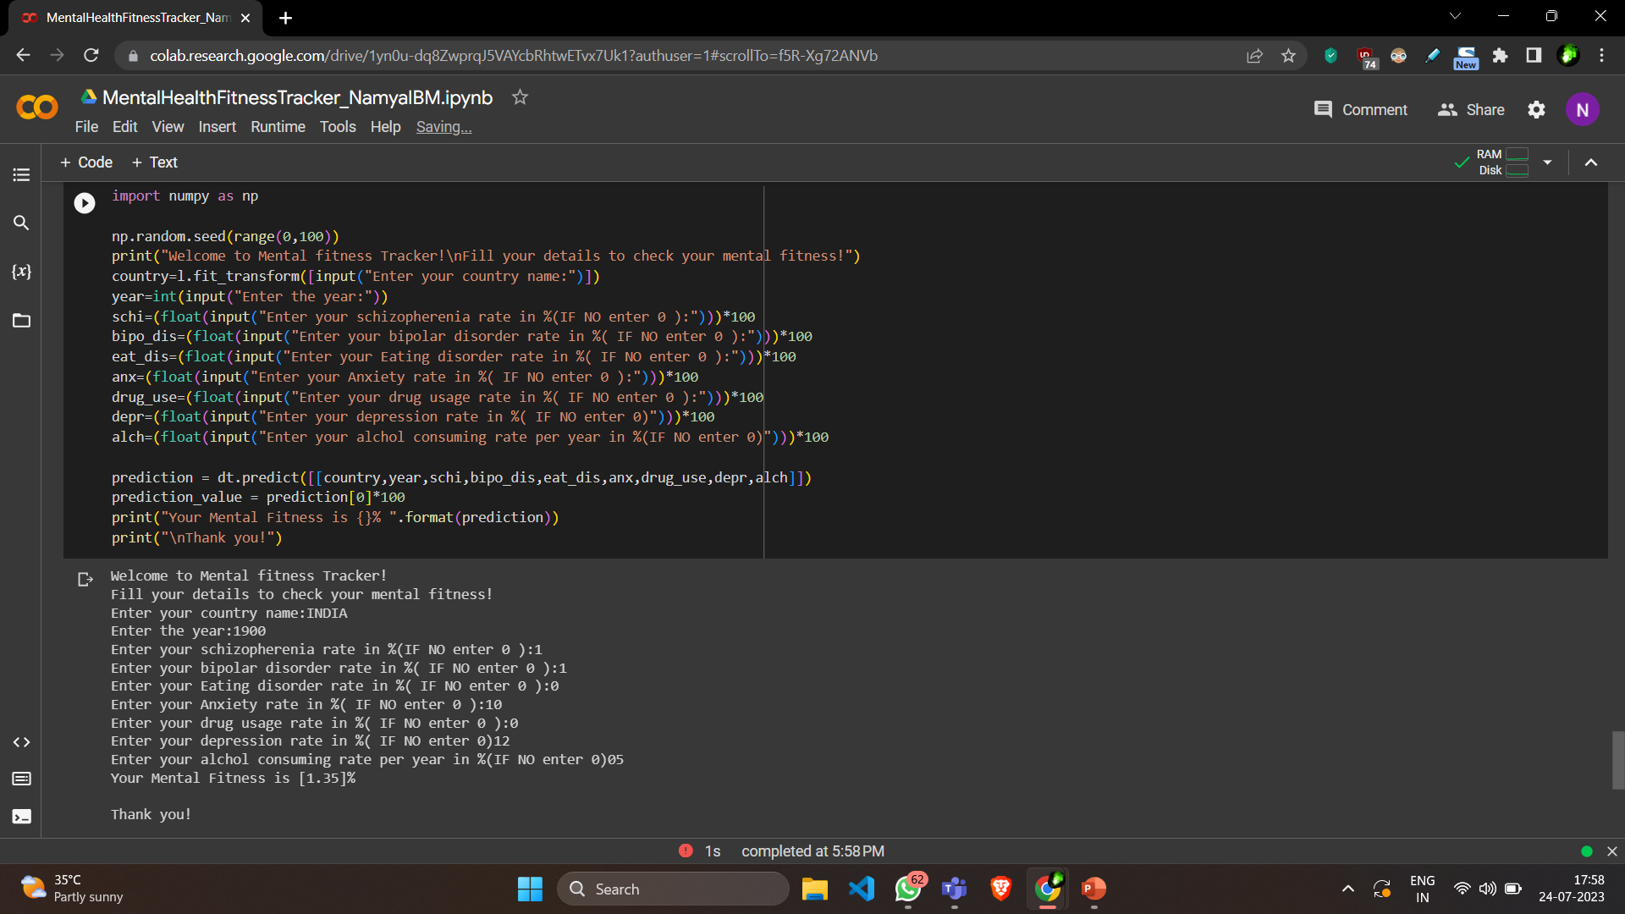
Results

Slide 10
links
https://github.com/namzezz/IBM-MENTAL_HEALTH_FITNESS_TRACKER_NAMYA.git

